Slide 1
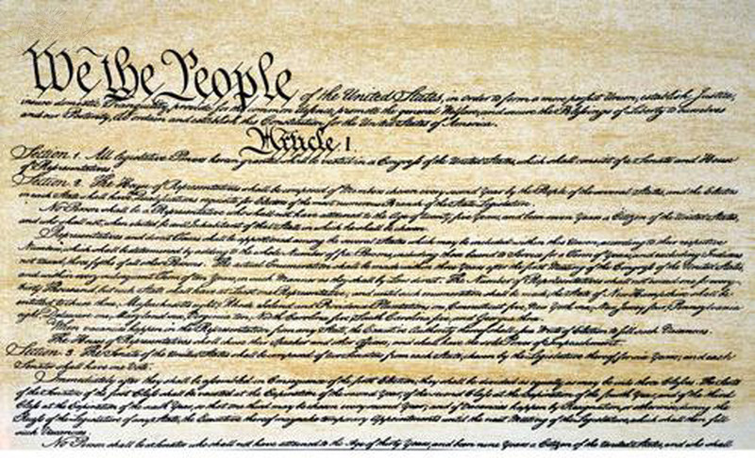
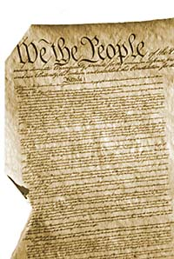
The Constitution is the supreme law of our land

Slide 2
The Magna Carta
(The Great Charter)
1215, England
Contained 63 clauses, promising all freemen access to courts and a fair trial
Eliminated unfair fines and punishments
Gave power to the Catholic Church in England

Slide 3
Idea taken from the Magna Carta:
Laws exist, and all citizens must obey them.
      King is not above the law.
  King cannot levy extra taxes “without the common consent of the realm.”
  Preserves the right of subjects to own property
  Limits the powers of the king and barons.
  Due Process of Law
  Judgment By One’s Peers

Slide 4
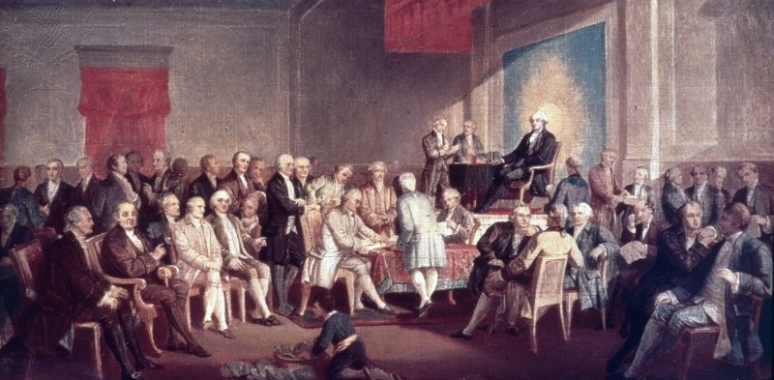
Constitution written in 1787 by 55 men whom we refer to as the Framers of the Constitution or our Founding Fathers.
To name a few: George Washington, James Madison, Alexander Hamilton, and Ben Franklin.

Slide 5
The introduction to the Constitution is called the Preamble.
It begins with “We the people…”
Meaning that our government is based on the consent of the people.

Slide 6
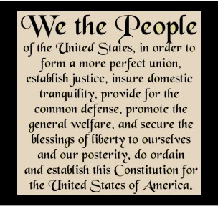

Slide 7
Amendment
A change in the Constitution
There have been 27 amendments to the Constitution.
The first 10 amendments are called the Bill of Rights.

Slide 8



1st Amendment
The 1st Amendment guarantees freedom of religion, speech, the press, assembly, and petition.
This means that we all have the right to:
  practice any religion we want
  to speak freely
  to assemble (meet)
  to address the government (petition)
  to publish newspapers, TV, radio, Internet (press)

Slide 9
2nd Amendment
The 2nd Amendment: A well regulated Militia, being necessary to the security of a free State, the right of the people to keep and bear Arms, shall not be infringed.
What does this ACTUALLY say?
Could the Founding Fathers have imagined 21st century weaponry?

Slide 10
3rd Amendment
The 3rd Amendment says “No soldier shall, in time of peace be quartered in any house, without the consent of the owner, nor in time of war, but in a manner to be prescribed by law.”
This means that we cannot be forced to house soldiers.
Notes:
During the Colonial Period, colonists were forced to let British soldiers sleep in their homes and eat their meals. Colonists were outraged, and the more they upset the British government, the more they were punished by having soldiers forced into their homes. The writers of The Bill of Rights wanted to make sure that this could never happen again so the Third Amendment was added.

Slide 11
4th Amendment
The 4th Amendment protects the people from unreasonable searches and seizures.
This means that the police must have a warrant to enter our homes.
It also means the government cannot take our property, papers, or us, without a valid warrant based on probable cause.

Slide 12
5th Amendment
No person shall be held to answer for a capital, or otherwise infamous crime, unless on a presentment or indictment of a Grand Jury, except in cases arising in the land or naval forces, or in the Militia, when in actual service in time of War or public danger; nor shall any person be subject for the same offence to be twice put in jeopardy of life or limb; nor shall be compelled in any criminal case to be a witness against himself, nor be deprived of life, liberty, or property, without due process of law; nor shall private property be taken for public use, without just compensation.

Slide 13
6th Amendment
The 6th Amendment guarantees:
A speedy trial
An impartial jury
That the accused can confront witnesses against them
The accused must be allowed to have a lawyer

Slide 14
7th Amendment
The 7th Amendment guarantees the right to trial by jury in a civil cases.
A civil trial is different from a criminal trial.
  Civil trial: when someone sues someone else.
  Criminal trial: when the state brings charges against someone

Slide 15
8th Amendment
The 8th Amendment guarantees that punishments will be fair and not cruel.

Slide 16
9th Amendment
The enumeration in the Constitution, of certain rights, shall not be construed to deny or disparage others retained by the people.
What does actually say and mean?
Notes:
The 9th Amendment to the US Constitution is one of the least referred to Amendments in decisions of the Supreme Court. It is also one of the most confusing, controversial and misunderstood Amendments to the Constitution. This amendment reserves all rights not listed in the Constitution to the people.

Slide 17
10th Amendment
The powers not delegated to the United States by the Constitution, nor prohibited by it to the States, are reserved to the States respectively, or to the people.
What does actually say and mean?

Slide 18
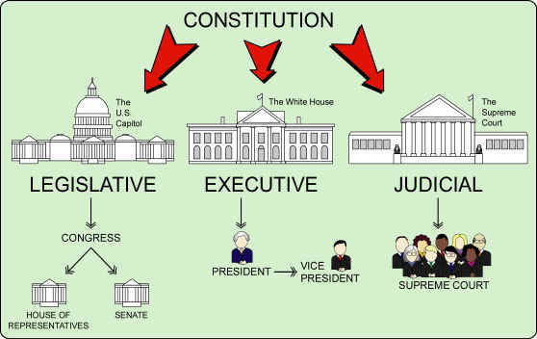
The Branches of Government
There are 3 branches of government:
1. The legislative - which makes the laws.
2. The executive - which enforces the laws or make sure the laws are carried out.
3. The judicial - which interprets the laws or explains the laws and makes sure they are fair.

Slide 19
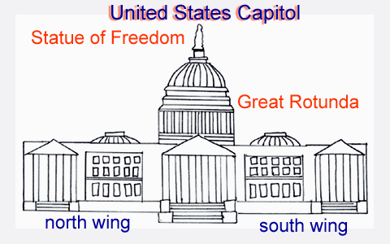
Legislative Branch
The legislative branch: CONGRESS
The House of Representatives
AND
The Senate

Slide 20
The House of Representatives
States with larger populations have more representatives.
House members must be at least 25 years old.
House members are elected to a 2 year term.
There are 435 members in the House.

Slide 21
The Senate
Each state has 2 US Senators
  For a total of 100 Senators in Congress.
Senators must be at least 30 years old.
Senators are elected to a 6 year term.

Slide 22

The Executive Branch
The President of the United States is head of the executive branch.
The president is also the commander-in-chief of the armed forces.

Slide 23

The President
The president is elected to a 4 year term.
Can only serve 2 terms.
Must be a citizen by birth.
And must be at least 35 years old.

Slide 24
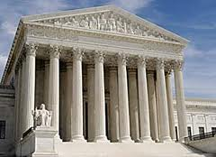
The Judicial Branch
The Judicial Branch of the federal government is headed by the Supreme Court.
The president nominates Supreme Court justices and must be approved by the Senate.
There are 9 Supreme Court justices, serve for life.

Slide 25
Checks and Balances
The framers of the Constitution sought to create a system that would prevent any one branch from obtaining too much power.
The power is to be shared in order to protect the people.
Example: Congress has the right to pass bills into law, but the president can veto them.

Slide 26
Federalism
Federalism: Governmental power divided between the states and the federal government.
States may make laws that are not dictated in the Constitution.
State law cannot contradict or over-rule federal law.

